Slide 1
ET 8306
OPTICAL COMMUNICATION SYSTEMS
Dr. Joseph Sospeter Salawa
Contacts: 0754556575
Email: yusufujss@gmail.com

Slide 2
Academic Qualification
Bachelor of Science in Telecommunications Engineering (UDSM 2011).
Masters of information Communication Science and Engineering (Electronics and Telecommunications Engineering option) (NMAIST 2016)
PhD in Electrical Engineering (Telecommunication option) (PAUSTI - 2024)

Slide 3
Course Contents
Theory of Optics
Introduction to Optical Fibers
Signal Degradation in Optical Fibers
Optical Sources and Transmitters
Optical Detectors and Receivers
Optical Link Design

Slide 4
MODE OF DELIVERY
This module will be delivered by way of
Lectures
Tutorials
Assignments
Group project

Slide 5
Reference Books
John M. Senior and Yousif Jamro, ―Optical Fiber Communications Principles and Practice‖, Third edition, 2009, Prentice Hall, ISBN: 978-0-13-032681-2
Govind P. Agrawal, Fiber-Optic Communication Systems, 3rd Edition, ISBN: 0-471-21571-6
Otto Strobel, ―Optical and Microwave Technologies for Telecommunication Networks‖, 2016, Wiley Publishers, ISBN: 978-1-119-97190-0
Azzedine Boudrioua, ―Photonic Waveguides‖, 2009, Wiley-ISTE , ISBN: 978-1-84821-027-1
Gines Lifante Pedrola, B‖eam Propagation Method for Design of Optical Waveguide Devices‖, 2015, Wiley Publishers, ISBN: 978-1-119-08337-5
Larry B. Stotts , ―Free Space Optical Systems Engineering: Design and Analysis‖, 2017, Wiley Publishers, ISBN: 978-1-119-27902-0

Slide 6
Time Table
DAY | TIME | VENUE
WEDNESDAY | 14:35 – 16:50 | TH 02

Slide 7
Introduction
The use of light for communication purposes dates back to antiquity if we interpret optical communications in a broad sense
Most civilizations have used mirrors, fire beacons, or smoke signals to convey a single piece of information (such as victory in a war).
Essentially the same idea was used up to the end of the eighteenth century through signaling lamps, flags, and other semaphore devices.
The idea was extended further, following a suggestion of Claude Chappe in 1792, to transmit mechanically coded messages over long distances (∼100 km) by the use of intermediate relay stations.
Optics is the field of science and engineering encompassing the physical phenomena associated with the generation, transmission, manipulation, detection and utilization of light.

Slide 8

Optics
Reflection
Diffuse reflection
Refraction
Index of refraction
Speed of light
Snell’s law
Geometry problems
Critical angle
Total internal reflection
Fiber optics
Mirages
Dispersion
Prisms
Rainbows

Slide 9
Reflection
Most things we see are thanks to reflections, since most objects don’t produce their own visible light.
Much of the light incident on an object is absorbed but some is reflected, the wavelengths of the reflected light determine the colors we see.
When white light hits an apple, for instance, primarily red wavelengths are reflected, while much of the others are absorbed.

Slide 10
A ray of light heading towards an object is called an incident ray. If it reflects off the object, it is called a reflected ray.
A perpendicular line drawn at any point on a surface is called a normal (just like with normal force).
The angle between the incident ray and normal is called the angle of incidence, i, and the angle between the reflected ray and the normal ray is called the angle of reflection, r.
The law of reflection states that the angle of incidence is always equal to the angle of reflection.

Slide 11
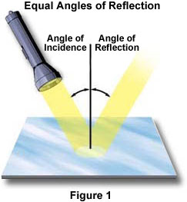
Law of Reflection
Normal line (perpendicular to surface)
i
r
reflected rays
incident rays
i = r

Slide 12

Diffuse Reflection
Diffuse reflection is when light bounces off a non-smooth surface. Each ray of light still obeys the law of reflection, but because the surface is not smooth, the normal can point in a different for every ray. If many light rays strike a non-smooth surface, they could be reflected in many different directions. This explains how we can see objects even when it seems the light shining upon it should not reflect in the direction of our eyes. It also helps to explain glare on wet roads: Water fills in and smoothes out the rough road surface so that the road becomes more like a mirror.

Slide 13
Speed of Light & Refraction
As you have already learned, light is extremely fast, about
3 × 10⁸ m/s in a vacuum. Light, however, is slowed down by the presence of matter. The extent to which this occurs depends on what the light is traveling through. Light travels at about 3/4 of its vacuum speed (0.75 c ) in water and about 2/3 its vacuum speed (0.67 c ) in glass. The reason for this slowing is because when light strikes an atom it must interact with its electron cloud. If light travels from one medium to another, and if the speeds in these media differ, then light is subject to refraction (a changing of direction at the interface).
Refraction of light waves
Refraction of light rays

Slide 14
Reflection & Refraction
At an interface between two media, both reflection and refraction can occur. The angles of incidence, reflection, and refraction are all measured with respect to the normal. The angles of incidence and reflection are always the same. If light speeds up upon entering a new medium, the angle of refraction, θ_{r} , will be greater than the angle of incidence, as depicted on the left. If the light slows down in the new medium, θ_{r} will be less than the angle of incidence, as shown on the right.
Reflected Ray
Reflected Ray
Incident Ray
Incident Ray
θ_{r}
Refracted Ray
normal
normal
Refracted Ray
θ_{r}

Slide 15
Axle Analogy
Imagine you’re on a skateboard heading from the sidewalk toward some grass at an angle. Your front axle is depicted before and after entering the grass. Your right contacts the grass first and slows, but your left wheel is still moving quickly on the sidewalk. This causes a turn toward the normal. If you skated from grass to sidewalk, the same path would be followed. In this case your right wheel would reach the sidewalk first and speed up, but your left wheel would still be moving more slowly. The result this time would be turning away from the normal. Skating from sidewalk to grass is like light traveling from air to a more
overhead view
“optically dense” medium like glass or water. The slower light travels in the new medium, the more it bends toward the normal. Light traveling from water to air speeds up and bends away from the normal. As with a skateboard, light traveling along the normal will change speed but not direction.
sidewalk
grass
θ_{r}

Slide 16
Index of Refraction, n
The index of refraction of a substance is the ratio of the speed in light in a vacuum to the speed of light in that substance:
c v
n =
Medium
Vacuum
Air (STP)
Water (20º C)
Ethanol
Glass
Diamond
n
1
1.00029
1.33
1.36
~1.5
2.42
n = Index of Refraction
c = Speed of light in vacuum
v = Speed of light in medium
Note that a large index of refraction corresponds to a relatively slow light speed in that medium.

Slide 17
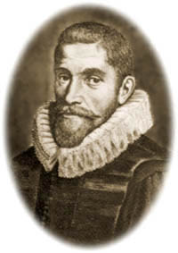
Snell’s Law
θ_{i}
n_{i}
n_{r}
θ_{r}
Snell’s law states that a ray of light bends in such a way that the ratio of the sine of the angle of incidence to the sine of the angle of refraction is constant. Mathematically,
n_{i} sinθ _{i} = n_{r} sinθ_{r}
Here n_{i} is the index of refraction in the original medium and n_{r} is the index in the medium the light enters. θ _{i} and θ_{r} are the angles of incidence and refraction, respectively.
Willebrord Snell

Slide 18
Refraction Problem #1
Goal: Find the angular displacement of the ray after having passed through the prism. Hints:
Find the first angle of refraction using Snell’s law.
Find angle ø. (Hint: Use Geometry skills.)
3. Find the second angle of incidence.
Find the second angle of refraction, θ, using Snell’s Law
19.4712º
79.4712º
Air, n₁ = 1
30°
10.5288º
Horiz. ray, parallel to
base
ø
θ
15.9º
Glass, n₂ = 1.5

Slide 19
Refraction Problem #2
Goal: Find the distance the light ray displaced due to the thick window and how much time it spends in the glass. Some hints are given.
20º
θ₁
1. Find θ₁ (just for fun).
2. To show incoming & outgoing
rays are parallel, find θ.
3. Find d.
4. Find the time the light spends in
the glass.
Extra practice: Find θ if bottom medium is replaced with air.
20º
H₂0
n₁ = 1.3
20º
0.504 m
glass
10m
n₂ = 1.5
5.2 · 10⁻⁸ s
d
θ
H₂0
26.4º

Slide 20
Refraction Problem #3
Goal: Find the exit angle relative to the horizontal.
θ =
19.8°
36°
air
glass
θ = ?
The triangle is isosceles.
Incident ray is horizontal, parallel to the base.

Slide 21
Reflection Problem
Goal: Find incident angle relative to horizontal so that reflected ray will be vertical.
θ =
10º
θ
50º
center of semicircular mirror with horizontal base

Slide 22
Critical Angle
The incident angle that causes the refracted ray to skim right along the boundary of a substance is known as the critical angle, θ_{c}. The critical angle is the angle of incidence that produces an angle of refraction of 90º. If the angle of incidence exceeds the critical angle, the ray is completely reflected and does not enter the new medium. A critical angle only exists when light is attempting to penetrate a medium of higher optical density than it is currently traveling in.
n_{r}
n_{i}
θ_{c}
From Snell,
n₁ sinθ_{c} = n₂ sin 90°
Since sin 90° = 1, we have n₁ sinθ_{c} = n₂ and the critical angle is
n_{r}
θ_{c} = sin⁻¹
n_{i}

Slide 23
Critical Angle Sample Problem
Calculate the critical angle for the diamond-air boundary.
Refer to the Index of Refraction chart for the information.
θ_{c} = sin⁻¹ (n_{r} / n_{i})
= sin⁻¹ (1 / 2.42)
= 24.4°
Any light shone on this boundary beyond this angle will be reflected back into the diamond.
air
diamond
θ_{c}

Slide 24
Total Internal Reflection
Total internal reflection occurs when light attempts to pass from a more optically dense medium to a less optically dense medium at an angle greater than the critical angle. When this occurs there is no refraction, only reflection.
n₁
n₂ >
n₁
n₂
θ
θ > θ_{c}
Total internal reflection can be used for practical applications like fiber optics.

Slide 25
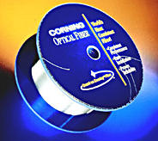
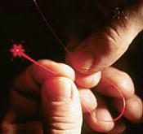
Fiber Optics
Fiber optic lines are strands of glass or transparent fibers that allows the transmission of light and digital information over long distances. They are used for the telephone system, the cable TV system, the internet, medical imaging, and mechanical engineering inspection.
spool of optical fiber
Optical fibers have many advantages over copper wires. They are less expensive, thinner, lightweight, and more flexible. They aren’t flammable since they use light signals instead of electric signals. Light signals from one fiber do not interfere with signals in nearby fibers, which means clearer TV reception or phone conversations.
A fiber optic wire
Continued…

Slide 26
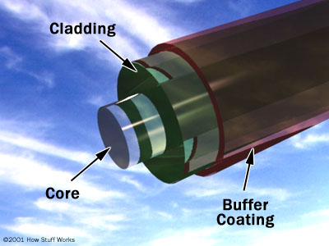
Fiber Optics Cont.
Fiber optics are often long strands of very pure glass. They are very thin, about the size of a human hair. Hundreds to thousands of them are arranged in bundles (optical cables) that can transmit light great distances. There are three main parts to an optical fiber:
Core- the thin glass center where light travels.
Cladding- optical material (with a lower index of refraction than the core) that surrounds the core that reflects light back into the core.
Buffer Coating- plastic coating on the outside of an optical fiber to protect it from damage.
Continued…

Slide 27
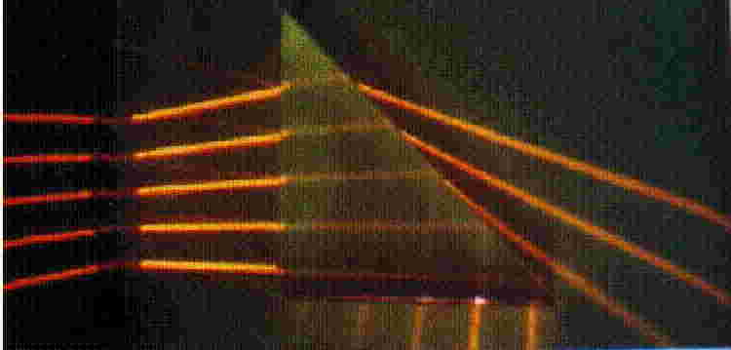
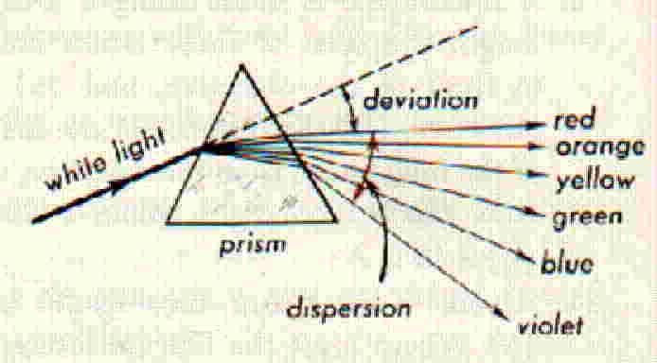
Dispersion of Light
Dispersion is the separation of light into a spectrum by refraction. The index of refraction is actually a function of wavelength. For longer wavelengths the index is slightly small. Thus, red light refracts less than violet. (The pic is exaggerated.) This effect causes white light to split into it spectrum of colors. Red light travels the fastest in glass, has a smaller index of refraction, and bends the least. Violet is slowed down the most, has the largest index, and bends the most. In other words: the higher the frequency, the greater the bending.
Animation

Slide 28
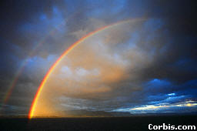
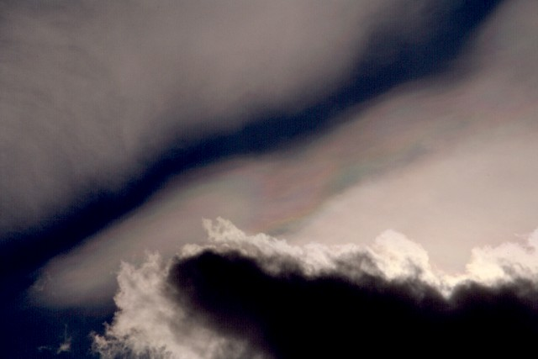
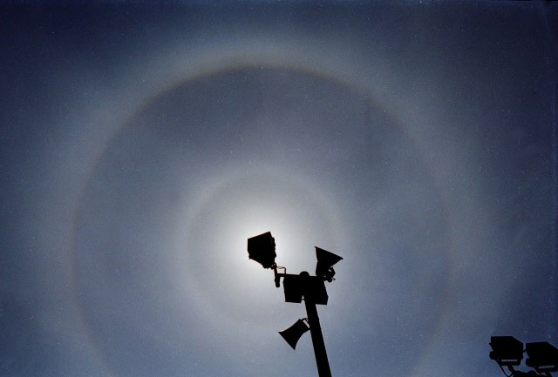
Atmospheric Optics
There are many natural occurrences of light optics in our atmosphere.
One of the most common of these is the rainbow, which is caused by water droplets dispersing sunlight. Others include arcs, halos, cloud iridescence, and many more.
Photo gallery of atmospheric optics.

Slide 29
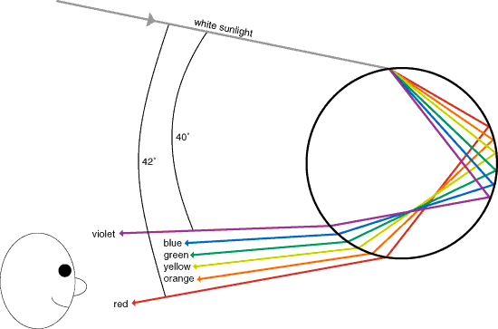
Rainbows
A rainbow is a spectrum formed when sunlight is dispersed by water droplets in the atmosphere. Sunlight incident on a water droplet is refracted. Because of dispersion, each color is refracted at a slightly different angle. At the back surface of the droplet, the light undergoes total internal reflection. On the
way out of the droplet, the light is once more refracted and dispersed. Although each droplet produces a complete spectrum, an observer will only see a certain wavelength of light from each droplet. (The wavelength depends on the relative positions of the sun, droplet, and observer.) Because there are millions of droplets in the sky, a complete spectrum is seen. The droplets reflecting red light make an angle of 42º with respect to the direction of the sun’s rays; the droplets reflecting violet light make an angle of 40º.
Rainbow images

Slide 30
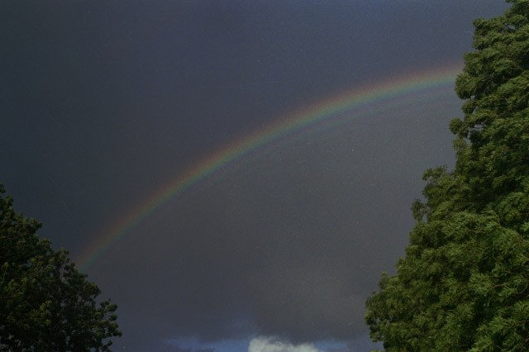
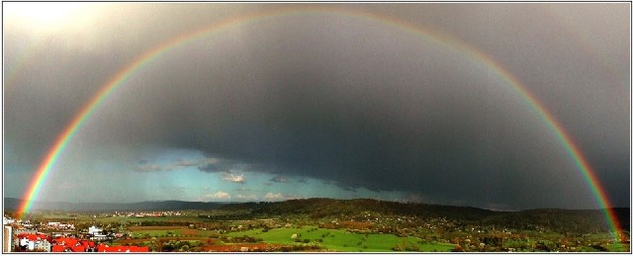
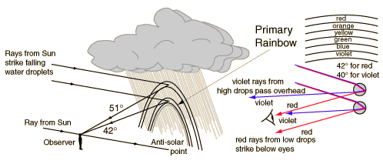
Primary Rainbow

Slide 31
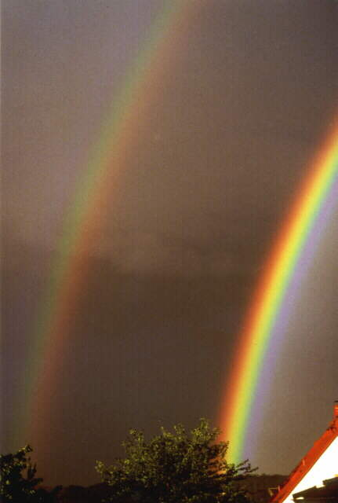
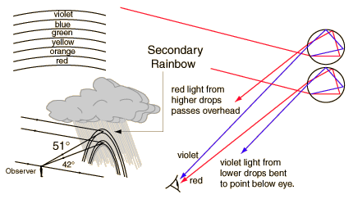
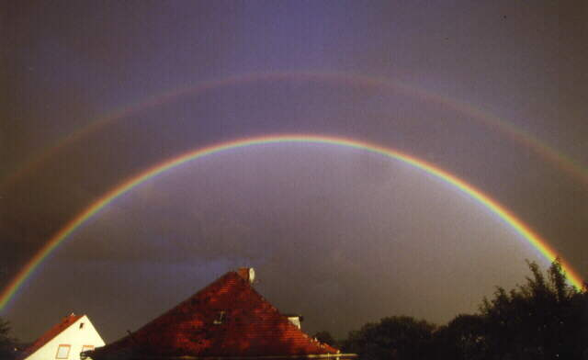
Secondary Rainbow
Secondary
The secondary rainbow is a rainbow of radius 51°, occasionally visible outside the primary rainbow. It is produced when the light entering a cloud droplet is reflected twice internally and then exits the droplet. The color spectrum is reversed in respect to the primary rainbow, with red appearing on its inner edge.
Primary
Alexander’s dark region

Slide 32
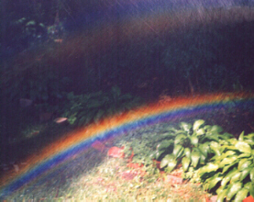
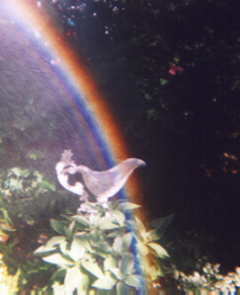
Supernumerary Arcs
Supernumerary arcs are faint arcs of color just inside the primary rainbow. They occur when the drops are of uniform size. If two light rays in a raindrop are scattered in the same direction but have take different paths within the drop, then they could interfere with each other constructively or destructively. The type of interference that occurs depends on the difference in distance traveled by the rays. If that difference is nearly zero or a multiple of the wavelength, it is constructive, and that color is reinforced. If the difference is close to half a wavelength, there is destructive interference.

